Slide 1
Overview of the Presentation
This presentation explores the preparation and application of standard solutions with varying pH (1–13), focusing on how different pH levels affect natural extracts from flowers and fruits, and how these can be used as natural pH indicators and dyes.
Key Highlights
Preparation of Standard pH Solutions
Step-by-step methods for preparing acidic, neutral, and basic solutions using common laboratory chemicals.
pH range covered: 1 (very acidic) to 13 (very basic).
Natural Indicators from Plant Extracts
Investigation into how flower and fruit extracts (such as red cabbage, beetroot, jamun, turmeric, moss rose, and hibiscus) change color at different pH levels.
Demonstrates the use of these extracts as natural pH indicators.
Application to Fabrics
Detailed process of treating cloth with natural dyes, using alum and sodium carbonate as mordants.
Observation of color changes on fabric after exposure to solutions of different pH values.
Examples include tie-dye techniques and the use of multiple plant extracts for varied color effects.
Observations and Results
Clear documentation of color changes before and after drying, and at different pH levels.
Notable findings, such as red cabbage extract turning from purple to dark blue at low pH, and from blue to yellow at high pH after drying.
Recipes for Natural Colors
Simple instructions for creating vibrant natural dyes from beetroot, hibiscus, turmeric, jamun, and red cabbage

Slide 2
Objective:
To prepare natural dyes using plant extracts and observe the color change on fabric when treated with solutions of different pH (1 to 13). This explores the behavior of natural indicators and eco-friendly dyeing techniques.
Materials Required:
Cotton fabric (washed and dried)
Detergent (for pre-washing)
Alum (KAl(SO₄)₂·12H₂O) – 5 g
Sodium carbonate (Na₂CO₃) – 2.5 g
Natural sources:
Red cabbage, turmeric, jamun peel, beetroot, hibiscus, moss rose
Distilled water
Beakers, measuring cylinder
pH buffer tablets (pH 1–13) or prepared solutions
Vinegar (acetic acid), NaOH (to make basic solutions)
Heating apparatus (gas burner or hot plate)
Rubber bands (for tie-dye patterns)
Spoon/spatula
pH paper or pH meter

Slide 3
Methodology:
A. Fabric Pretreatment (Mordanting)
Wash the cotton fabric in hot water with detergent to remove any finish or starch.
Prepare the mordant solution:
Mix 2.5 g Na₂CO₃ and 5 g alum in ~200 mL water.
Boil the fabric in this solution for 10–15 minutes.
Dry the fabric in direct sunlight
Sample Observations
Natural Dye | pH | Color Before Drying | Color After Drying
Red cabbage | 1 | Purple | Dark bluish
Red cabbage | 10 | Blue | Yellow
Jamun peel | 10 | Green | Blue
Turmeric + Na₂CO₃ | — | Reddish | Reddish fixed
Hibiscus + Vinegar | — | Red solution | Light blue on cloth

Slide 4
Observation of colour at different ph at different flower and fruits-
Source | Condition / Additive | Observed Color | Notes
1 | Red Cabbage | (Na₂CO₃) | 🟢 Green | May turn blue on fabric after drying
2 | Red Cabbage | + pH 1 | 🟣 Purple | Turns dark bluish after drying
3 | Turmeric | +PH5 | 🟡 Yellow | Natural base color of turmeric
4 | Turmeric | + Na₂CO₃ | 🔴 Red | Turns reddish in basic medium
5 | Jamun Peel | + pH 10 | 🟢 Green → 🔵 Blue | Green first, turns blue after drying on cloth
6 | Jamun Peel | + pH 1 | 🟤 Brownish-Red | Visible reddish-brown tone
7 | Beetroot | — (Neutral Water) | 🔴 Deep Red | Works well as a natural dye
8 | Hibiscus | + Vinegar | 🔴 Red → 🔵 Light Blue | Appears red; turns light blue on fabric
9 | Moss Rose | + pH 1 | 🌸 Pink | Delicate pink color in acidic medium

Slide 5
Preparation of Standard Solutions of Varying pH (1–13)
Acidic Range (pH 1–6):
pH 1: 20 mL of 0.1 M HCl.
pH 2: 20 mL of 0.01 M HCl + 20–30 drops of 0.1 M HCl to adjust pH.
pH 3: 10 mL of 0.1 M CH₃COOH + 10 mL of pH 4 solution; adjusted with 2-10 drops of pH 4.
pH 4: Standard pH 4 buffer (prepared from tablet content in distilled water).
pH 5: 10 mL of pH 4 + 10 mL of pH 7 (6.9 mL of pH 7 added for fine adjustment).
pH 6: 10 mL of pH 7 + 10 mL of pH 4 + 5-10 extra drops of pH 7 for adjustment
Neutral (pH 7):
pH 7: Standard pH 7 buffer solution.
Basic Range (pH 8–13):
pH 8: 10 mL of pH 9 + 10 mL of pH 7 (20 mL of pH 9 used).
pH 9: Standard pH 9 buffer solution.
pH 10: 0.1 M Na₂CO₃ adjusted with 10 mL of pH 9.
pH 11: 0.2 M Na₂CO₃ + 2.3 mL of 0.01 M NaOH.
pH 12: 0.01 M NaOH solution.
pH 13: 0.1 M NaOH solution (added extra NaOH pellets for higher concentration).

Slide 6
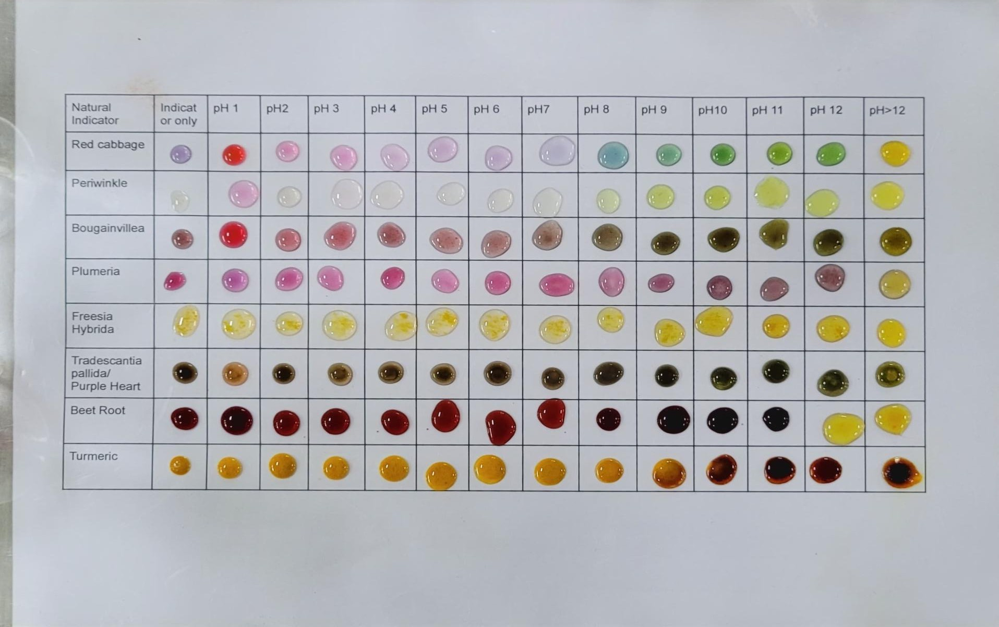
We observed the effect of different pH levels on flower extracts to study their natural indicator properties-

Slide 7
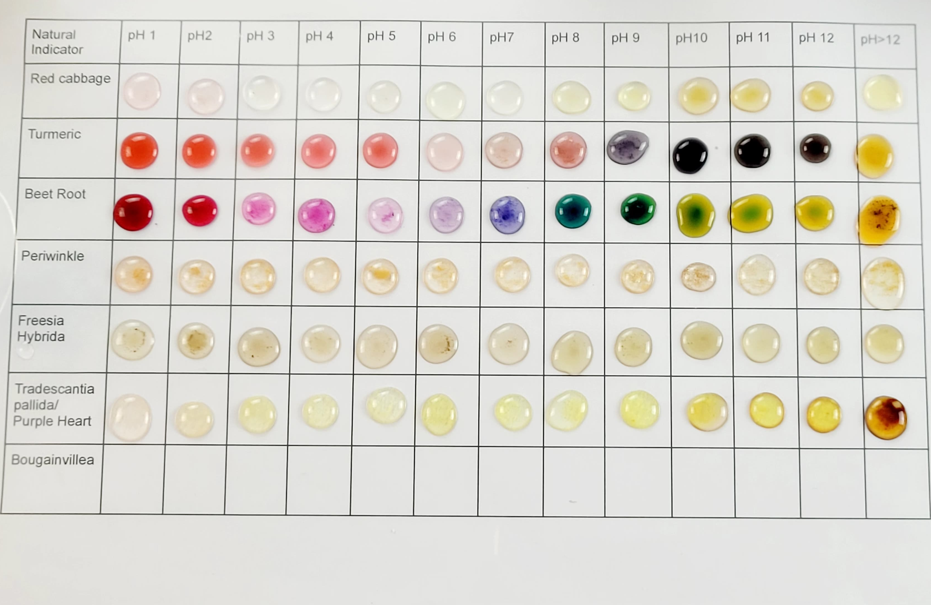

Slide 8
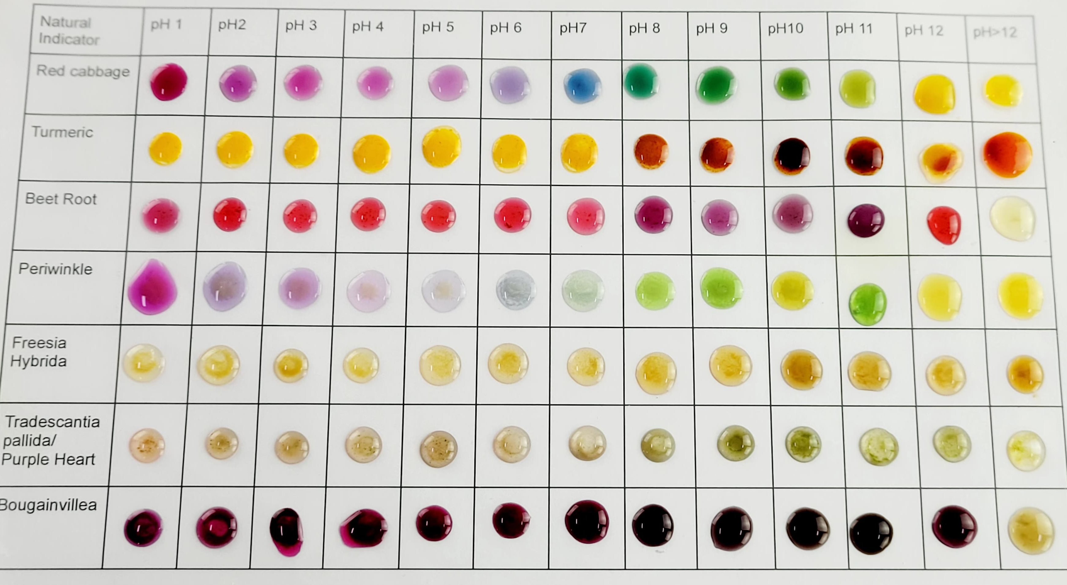

Slide 9
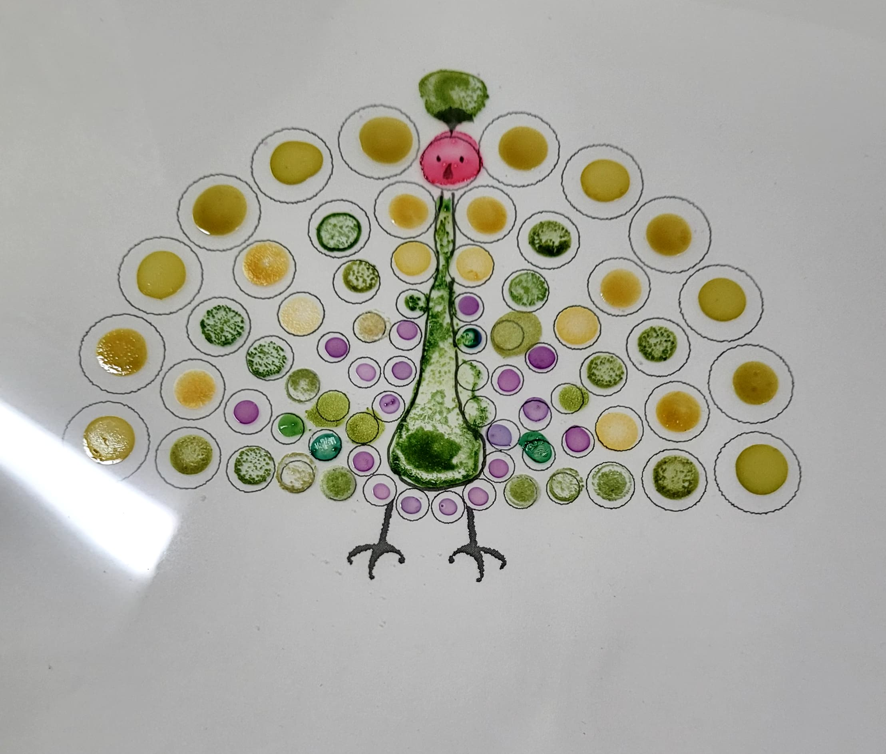
Make a peacock image by using droplet art-

Slide 10
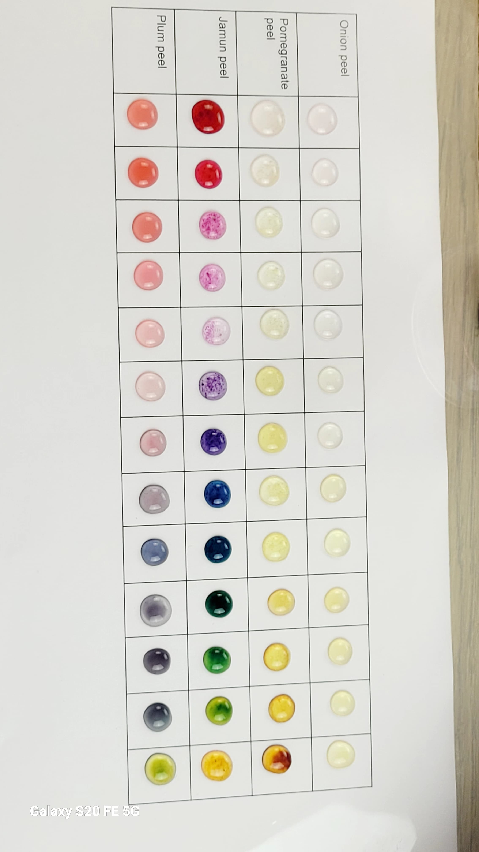
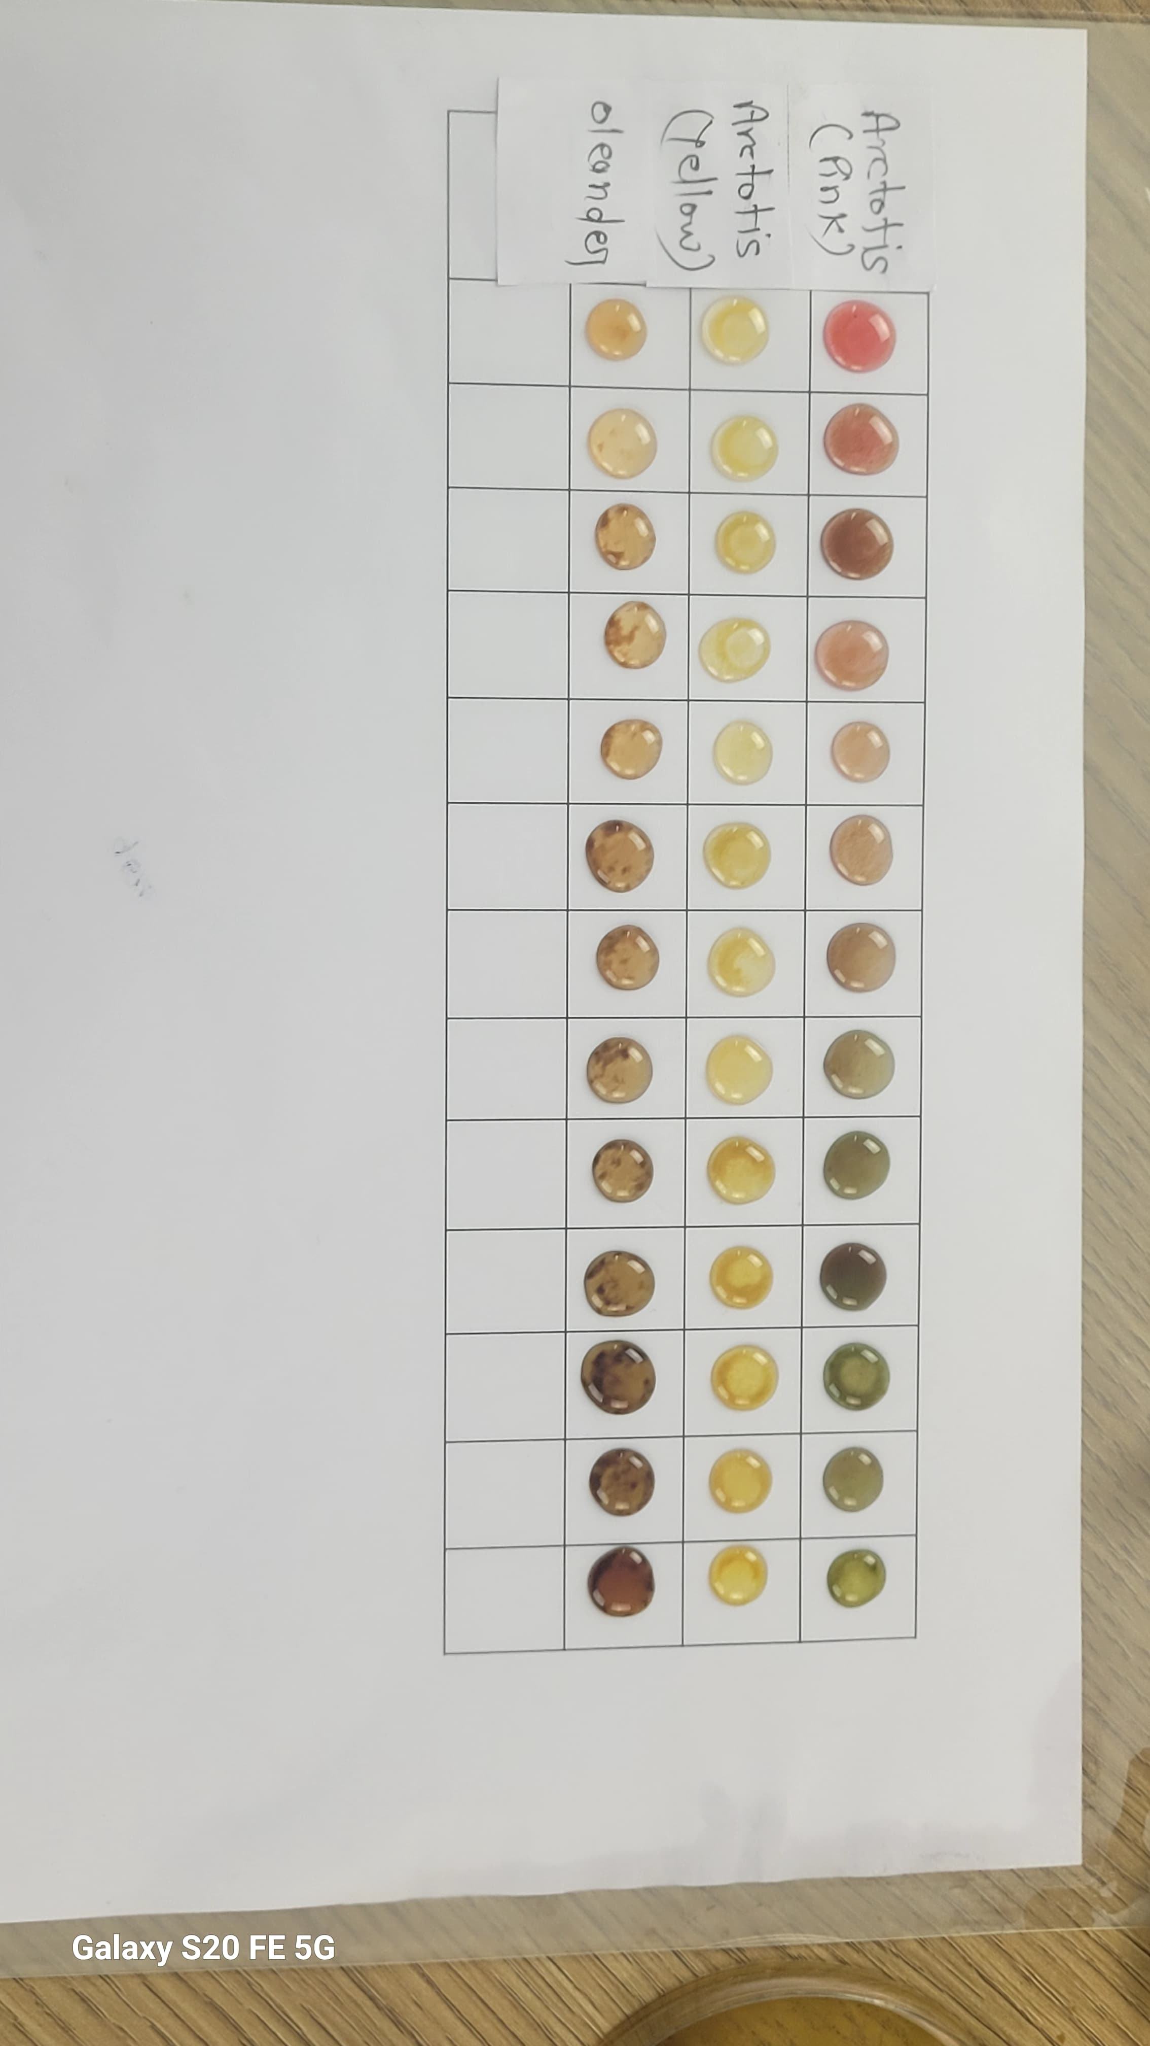
We observed the effect of different pH levels on fruits extracts to study their natural indicator properties-

Slide 11
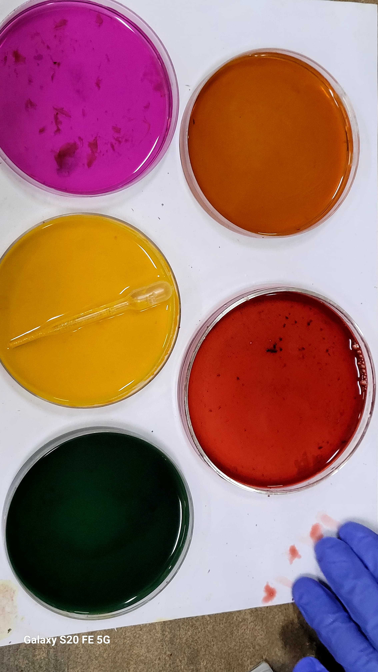
By using jamun and red cabbage +beet root and turmeric make different type of color -
Beet root +ph3
Pomegranate+ph10
Jamun+ph10
MOSS ROSE+PH1
Turmeric+ph5

Slide 12
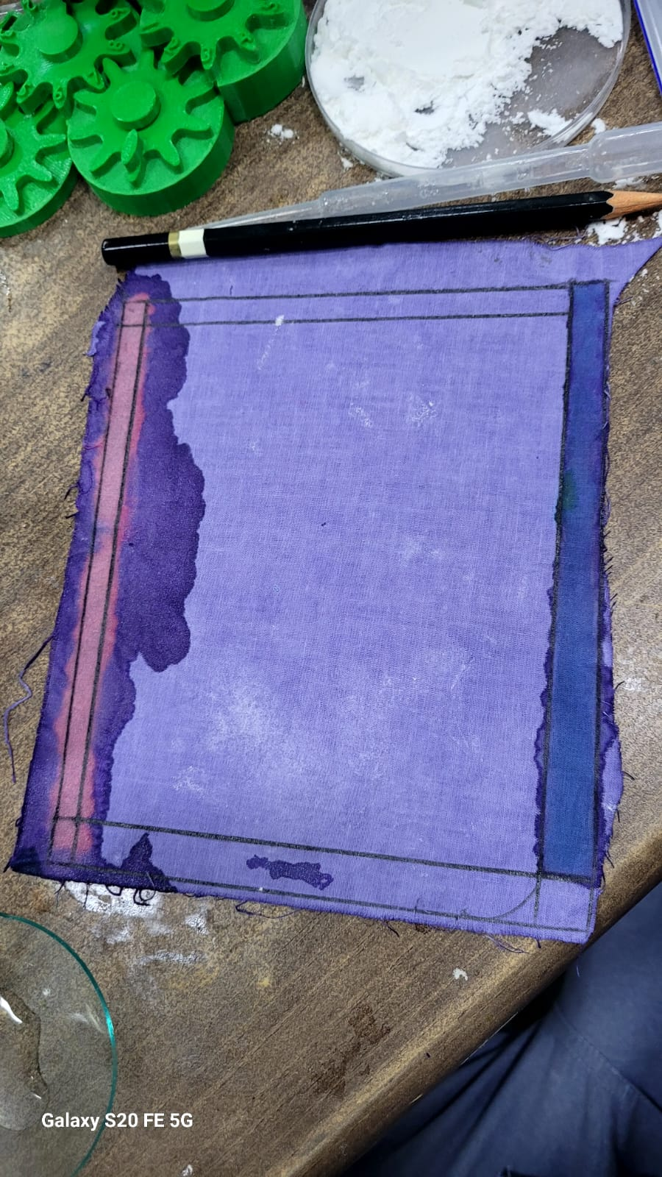
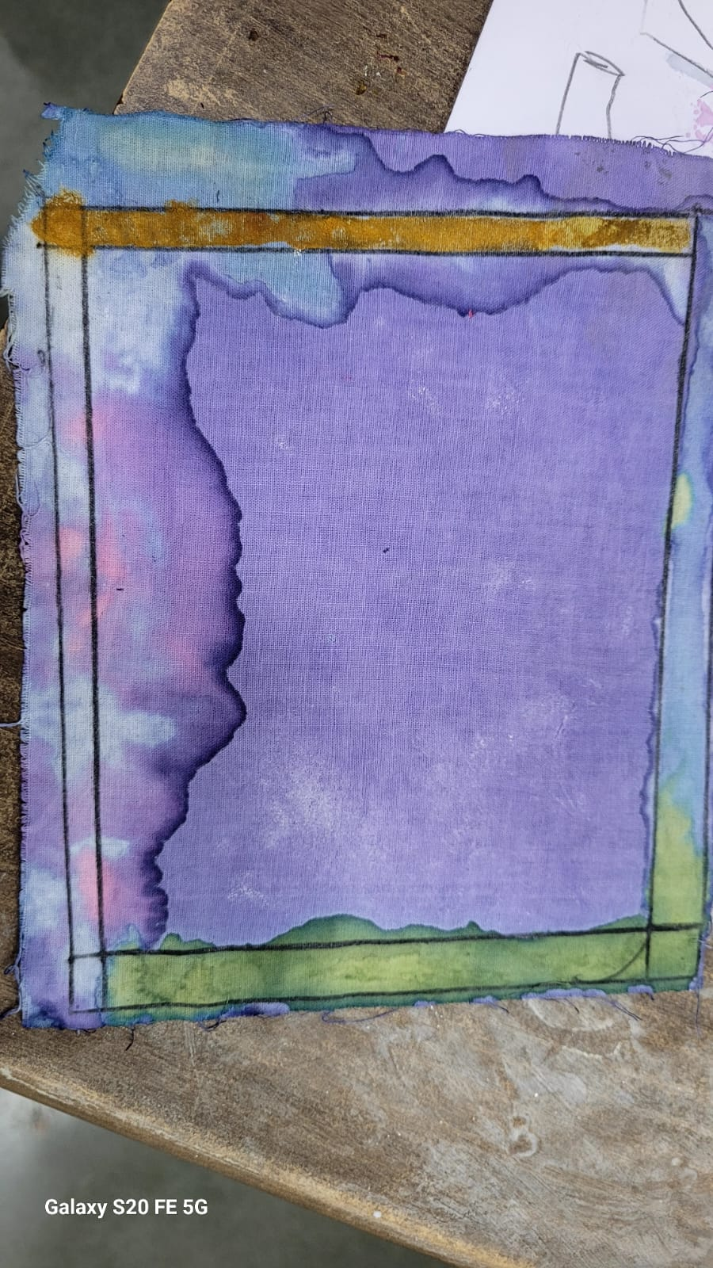
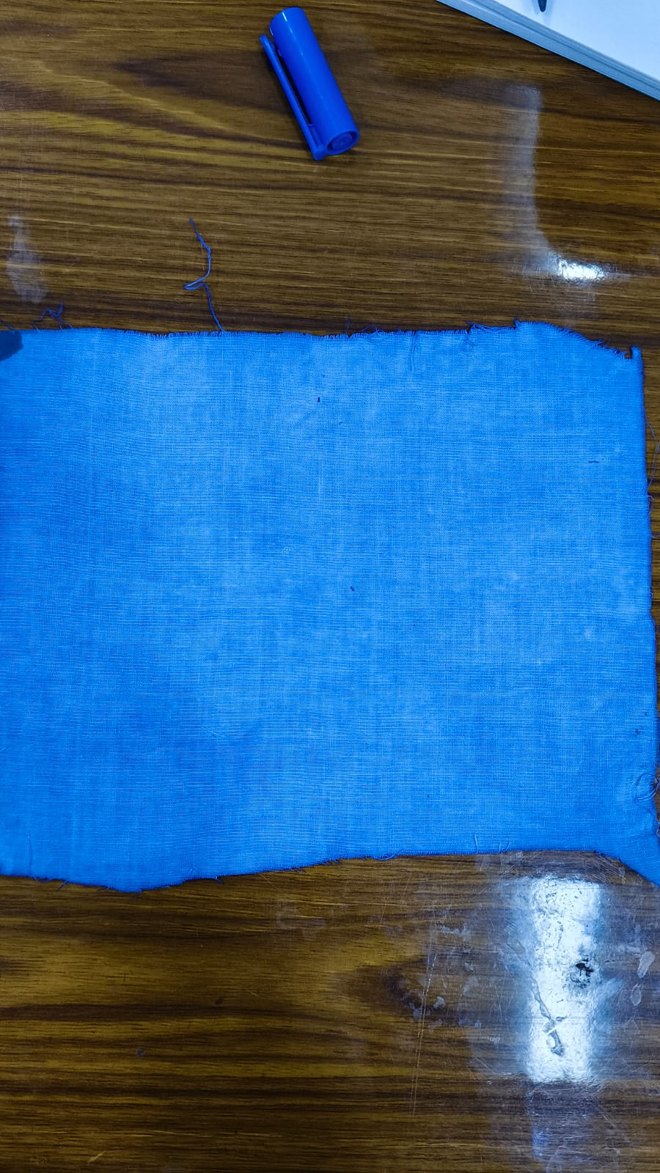
Firstly, we boiled the cloth in a mixture of water, Na₂CO₃ (2.5 g), and alum (5 g). After that, we placed the cloth under sunlight for drying. Once dried, then boiled again with red cabbage. After this step, the cloth was again placed under sunlight to dry. Once fully dried, we tested the cloth using pH 1 and pH 10 solutions to observe the effect of red cabbage as a natural indicator on the fabric-
Red cabbage +modarante clothes boil together
Ph1
(Observation)
① At pH 1 → showed purple colour before drying but after drying purple colour changed in dark bluish.
② At pH 10 → showed blue colour but after drying it showed → yellow colour .
Before drying
After drying

Slide 13
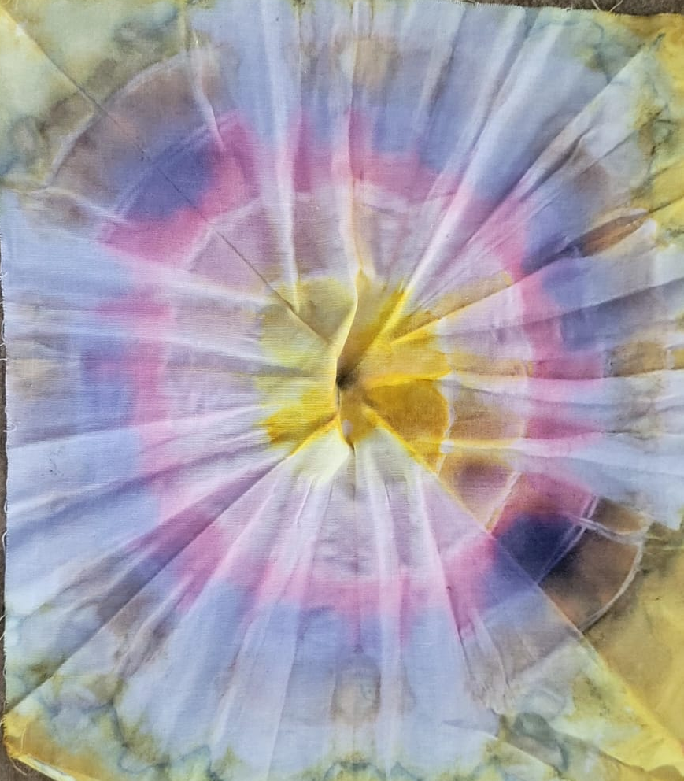
Firstly, we boiled the cloth in a mixture of water, Na₂CO₃ (2.5 g), and alum (5 g). After that, we placed the cloth under sunlight for drying.
Red Cabbage +ph1
Mose rose
Turmeric +Na2Co3
Turmeric
Red Cabbage+ph10

Slide 14
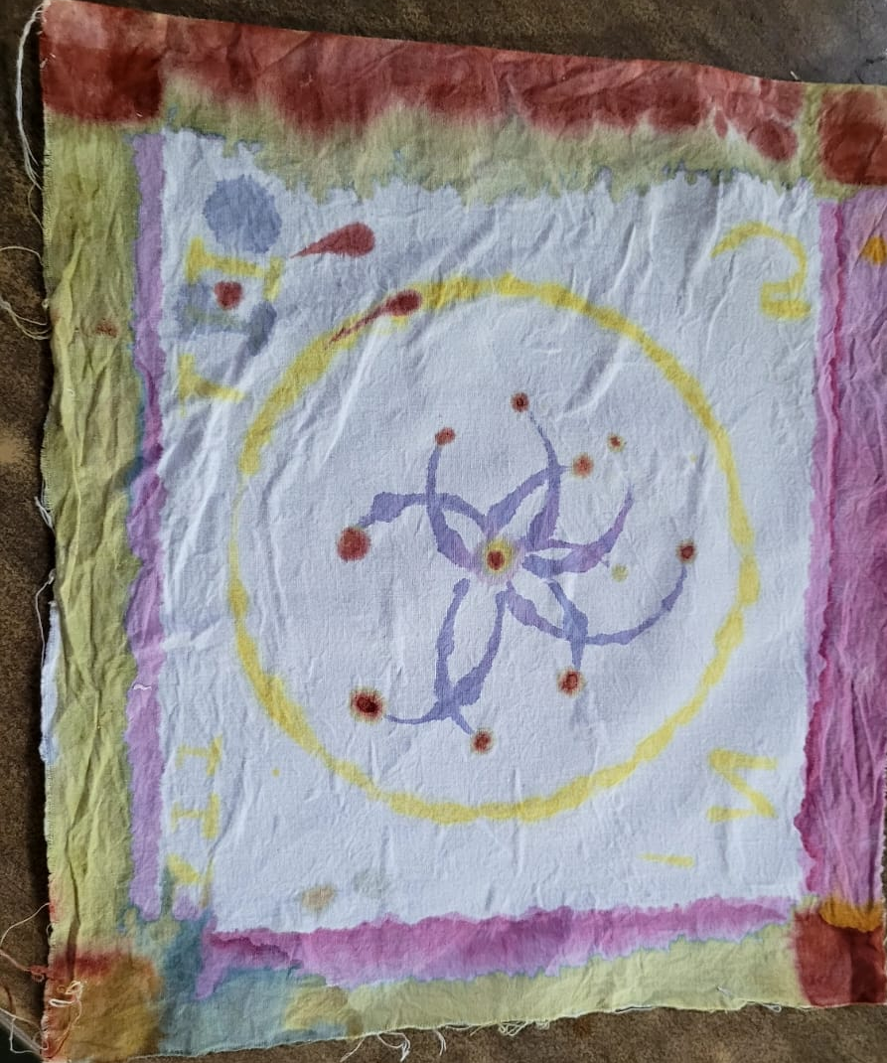
Firstly, we washed the cloth in hot water using detergent. After drying, the cloth was boiled in a mixture of water, Na₂CO₃ (2.5 g), and alum (5 g). Once this treatment was complete, the cloth was dried again under sunlight. After drying, we applied different natural colors to various parts of the cloth, as seen in the image-
Turmeric+Na2Co3(red)
Turmeric(yellow)
Na2co3+red Cabbage
Only Red Cabbage(blue)
Moss Rose (pink )

Slide 15
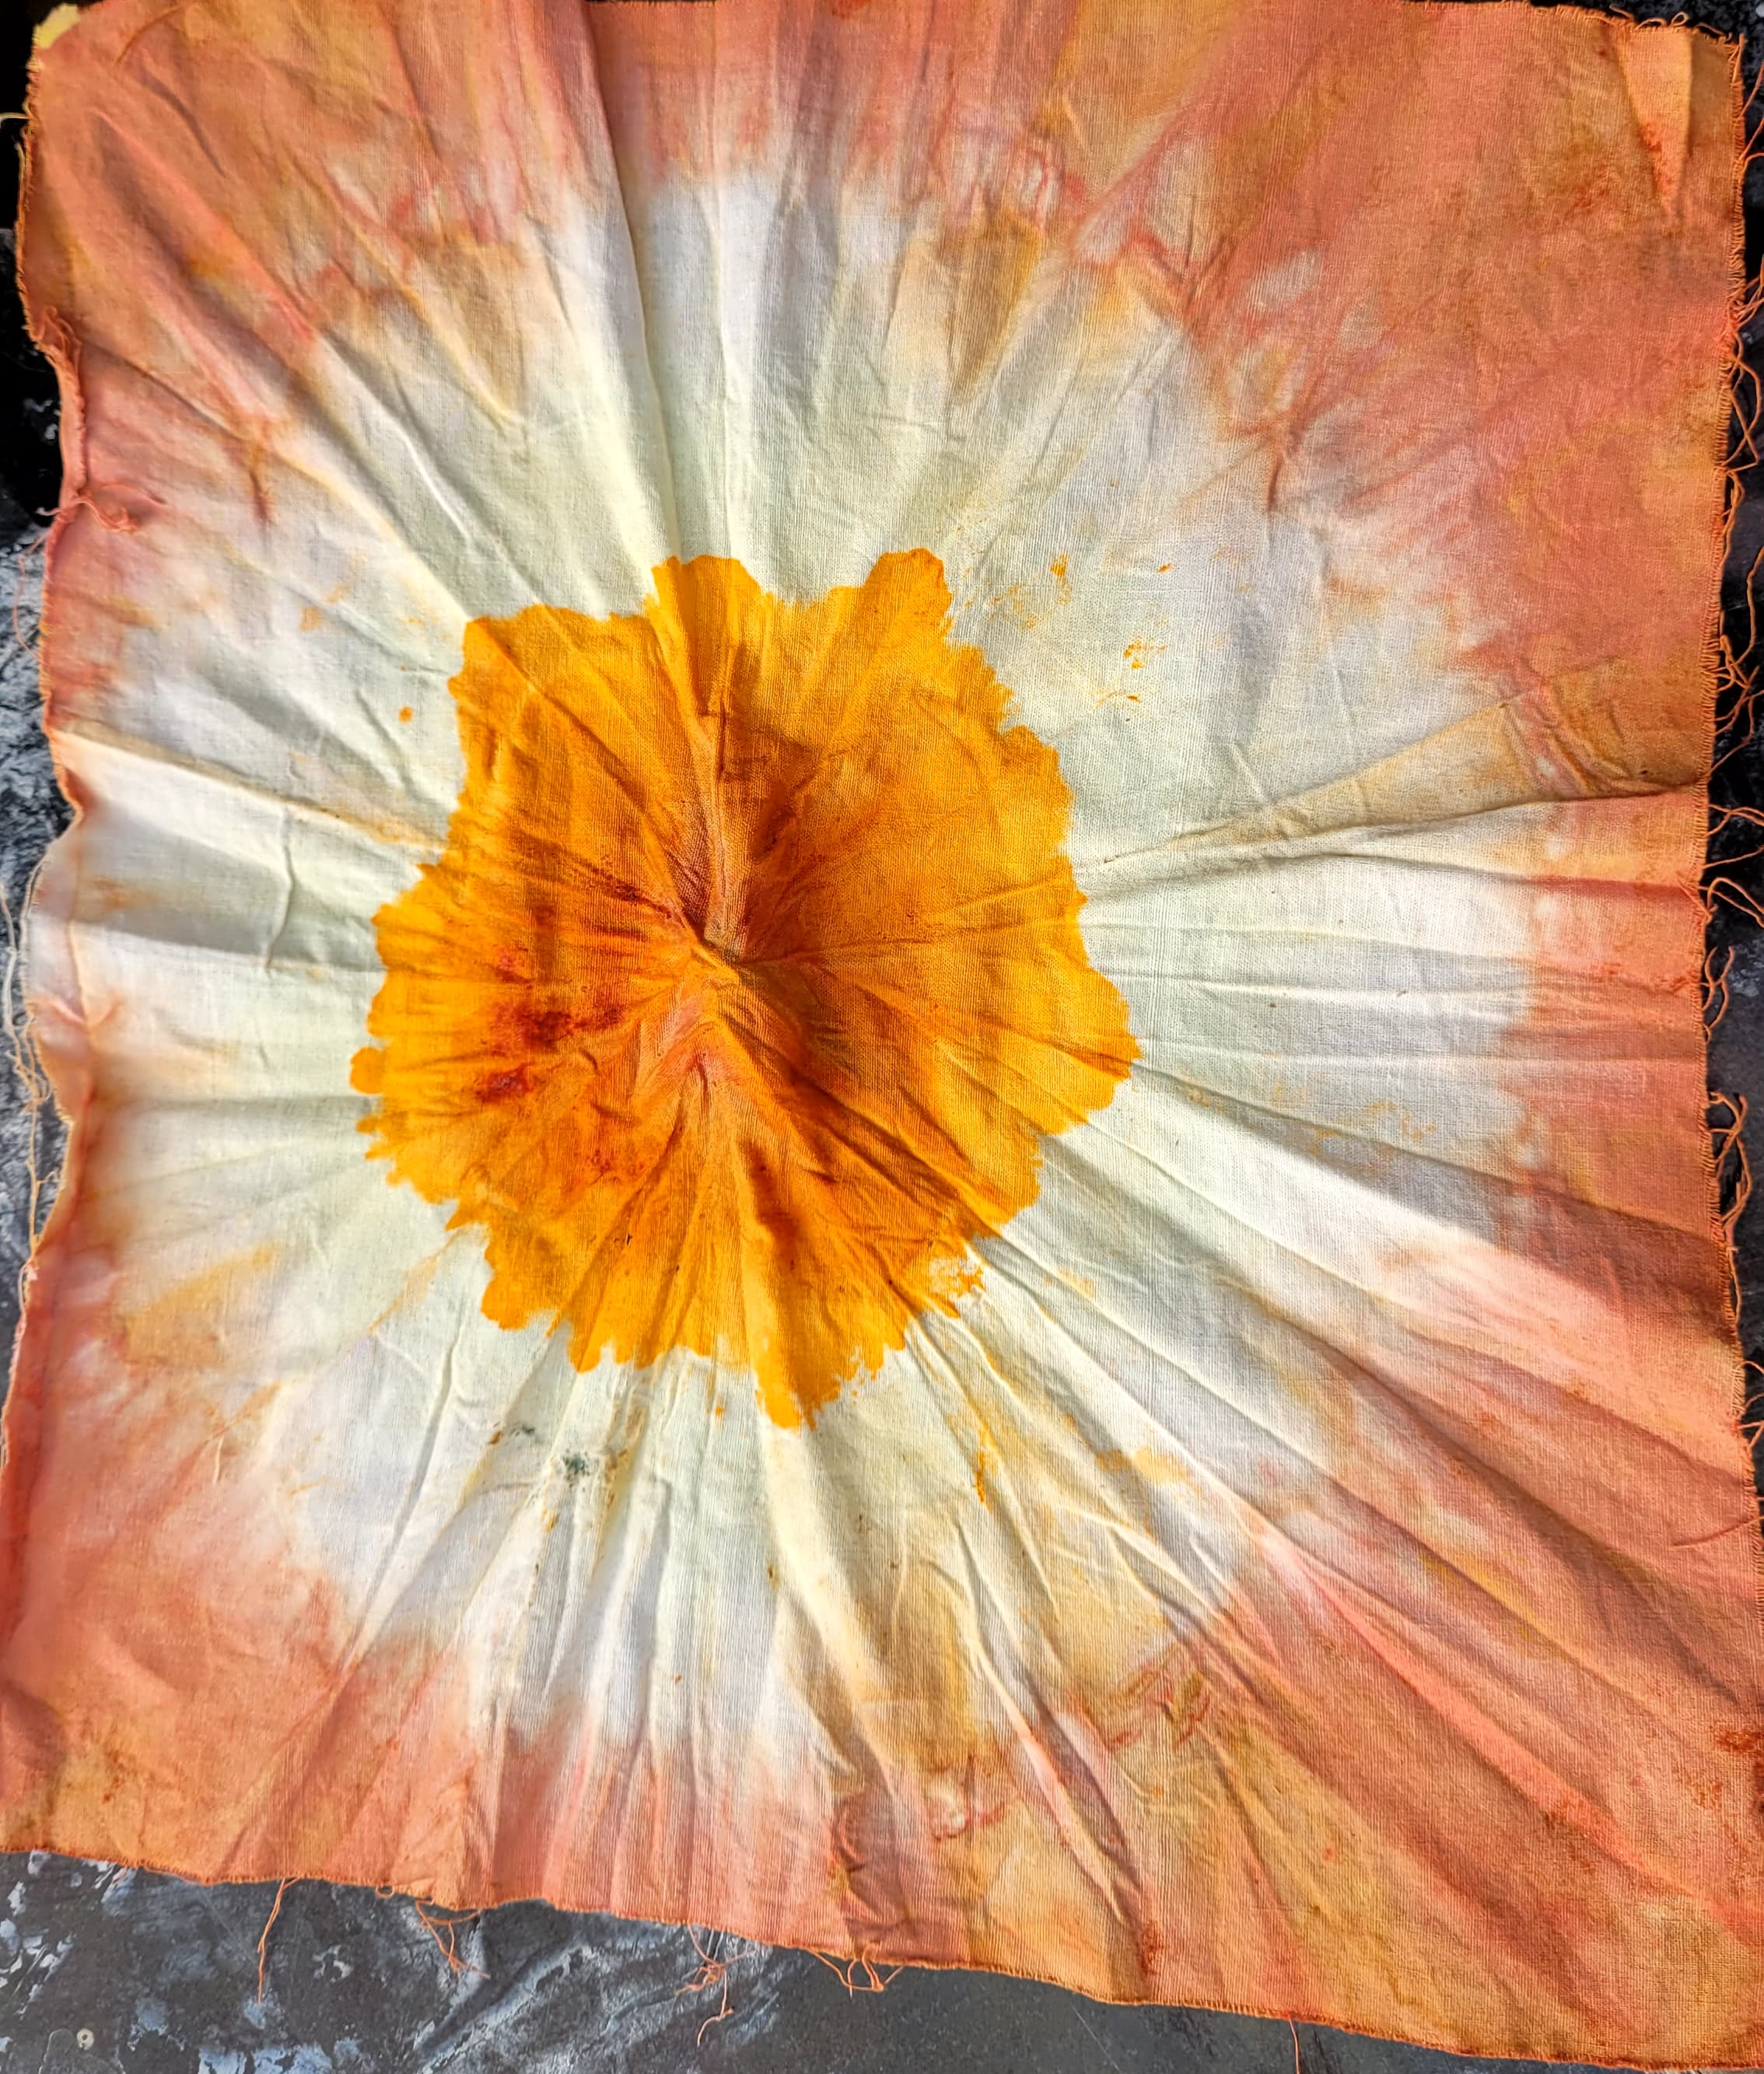
Firstly, we boiled the cloth in a mixture of water, Na₂CO₃ (2.5 g), and alum (5 g). After that, we placed the cloth under sunlight for drying. Then, we tied knots in the cloth and marked them with rubber bands at specific intervals. The first knot was dipped in turmeric solution, the second knot was left blank, and the third knot was treated with a solution of Na₂CO₃ and turmeric (which gives a red color).
Turmeric
Na2Co3+Turmeric

Slide 16
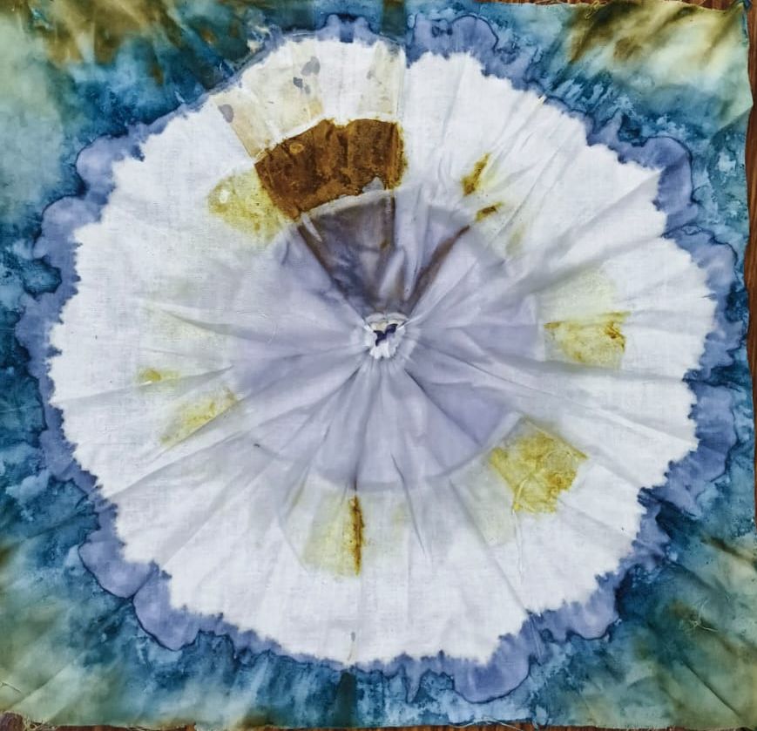
Firstly, we washed the cloth in hot water using detergent. After drying, the cloth was boiled in a mixture of water, Na₂CO₃ (2.5 g), and alum (5 g). Once this treatment was complete, the cloth was dried again under sunlight. After drying, we applied different natural colors to various parts of the cloth, as seen in the image
Turmeric
Hibiscus mixed with vinegar gives a red-colored solution, but after dipping the clothe into it, the color changes to light blue.
Red cabbage extract mixed with Na₂CO₃ gives a green color, but after applying it to clothes, the green color changes to blue.

Slide 17
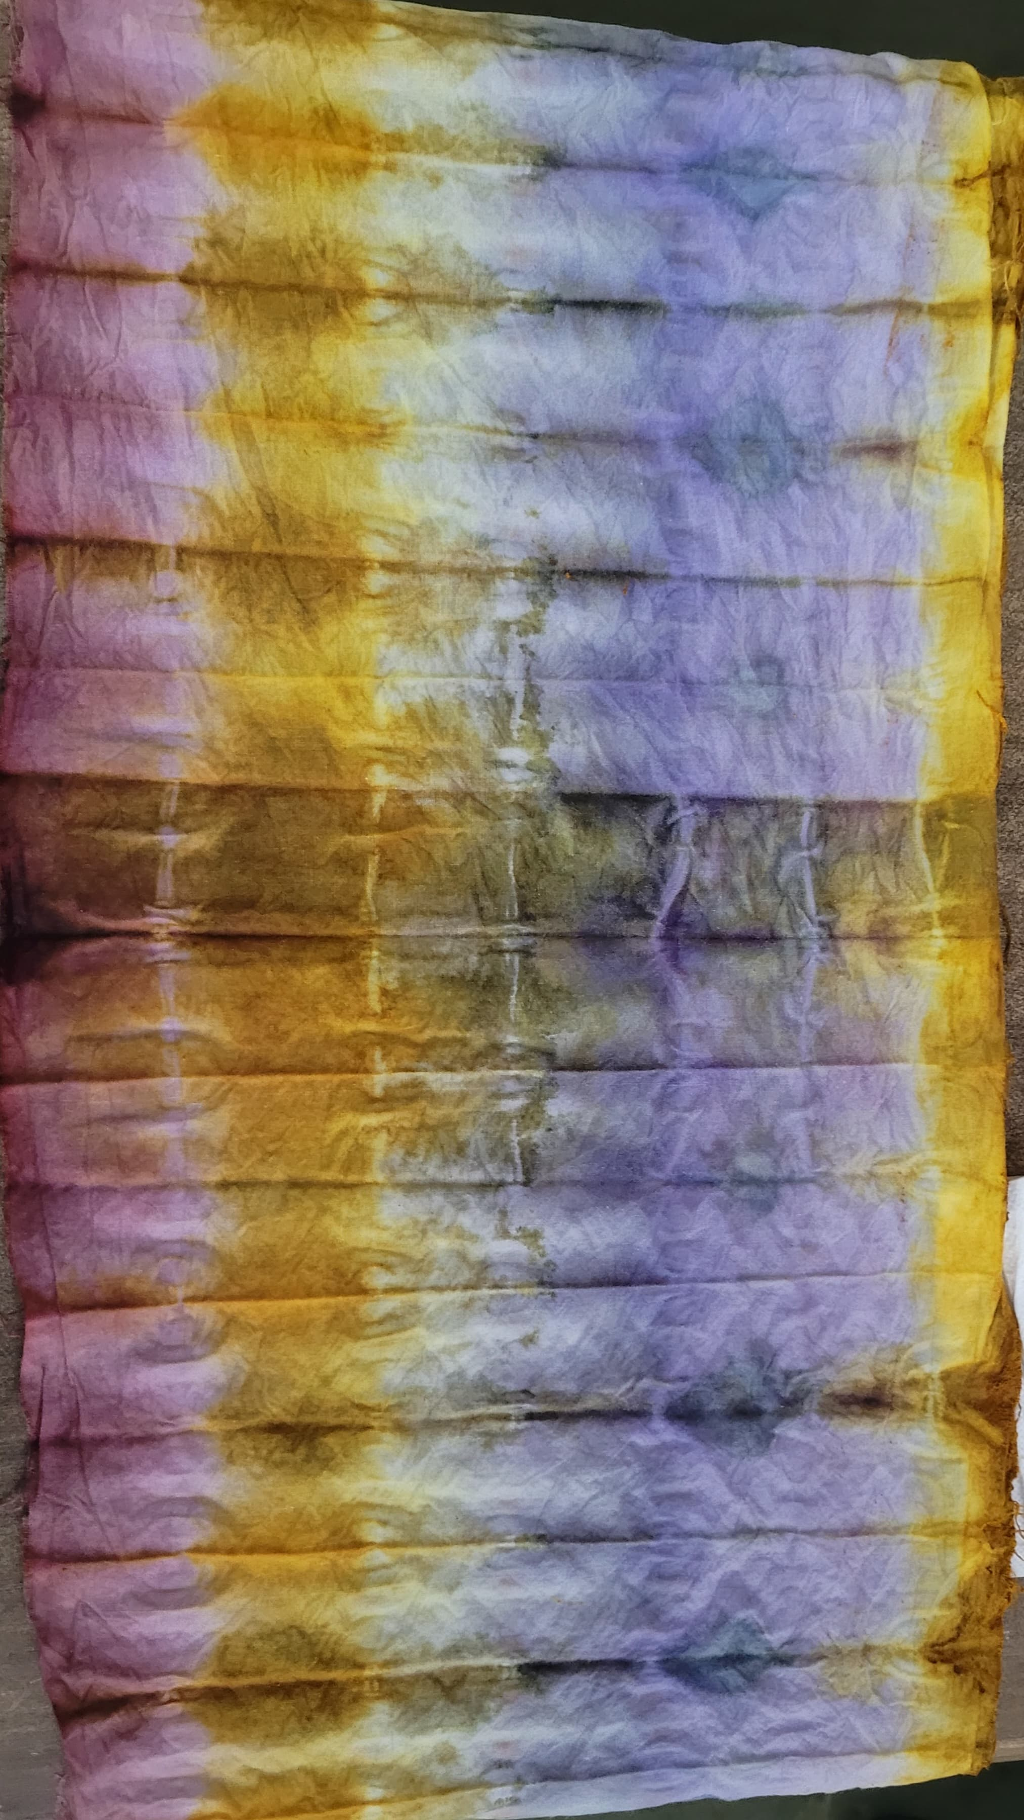
Firstly, we washed the cloth in hot water using detergent. After drying, the cloth was boiled in a mixture of water, Na₂CO₃ (2.5 g), and alum (5 g). Once this treatment was complete, the cloth was dried again under sunlight. After drying, we applied different natural colors to various parts of the cloth, as seen in the image-
Jamun peel with pH 10 initially shows a green color, which turns blue after drying
Turmeric +Ph 4-7(yellow colour)
Jamun peel + PH 1 (brownish reddish colour)
Mosh Rose +PH 1(pink colour)

Slide 18
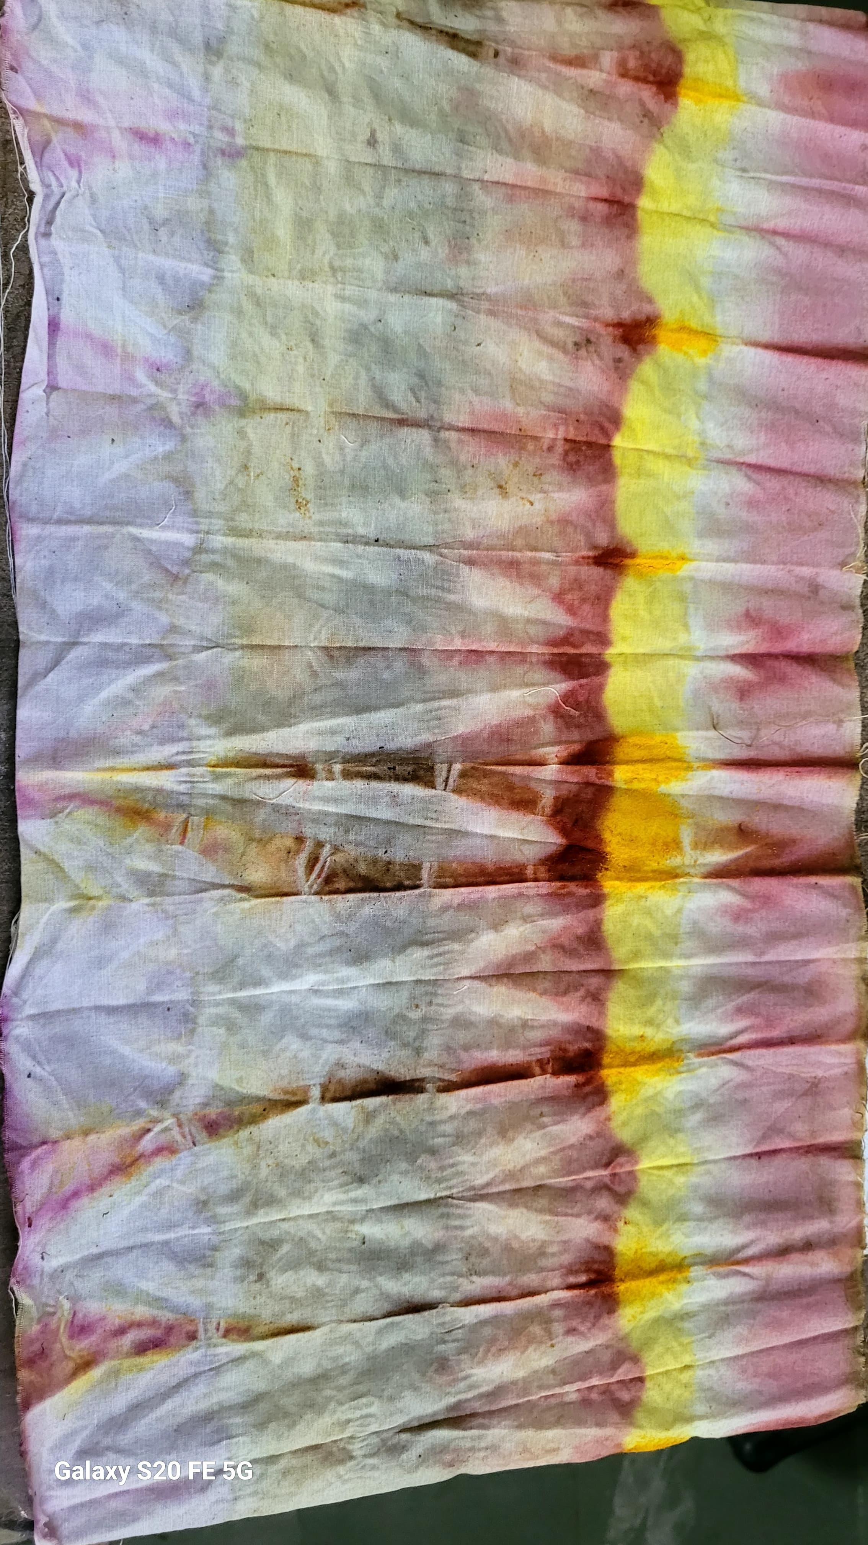
Mosh Rose +PH 1(pink colour)
Turmeric +Ph 4-7(yellow colour)
Jamun peel with pH 10 initially shows a green color, which turns blue after drying

Slide 19
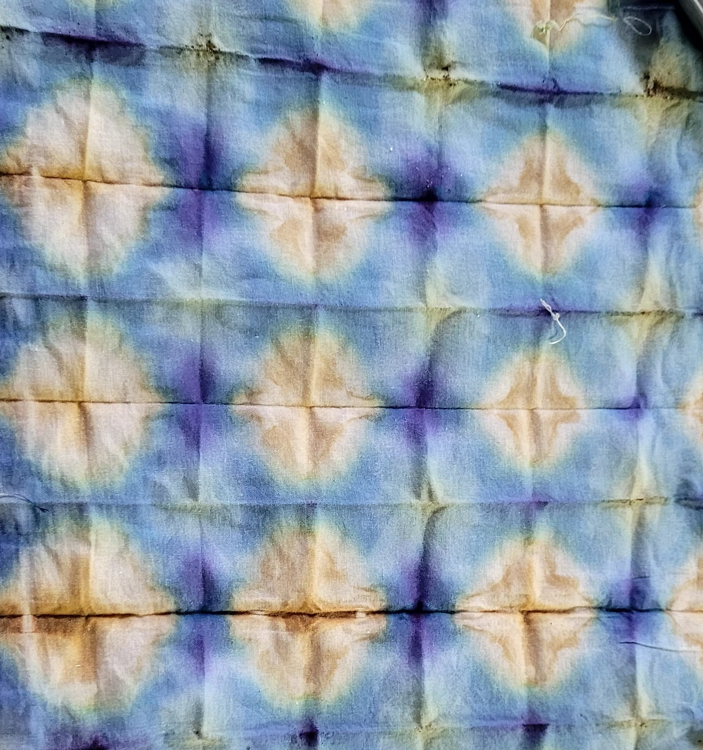
Jamun+ph10=green turns into blue
Jamun+ph12 gives yellow colour

Slide 20
overview
The presentation demonstrates the versatility and effectiveness of natural extracts as both pH indicators and eco-friendly dyes. It highlights the interplay between chemistry and art, showing practical, visually engaging results that can be applied in educational, scientific, and creative context

Slide 21
Cyanotype Process-
Solution Preparation:
Potassium ferricyanide – 0.8 g per 10 mL
Ammonium ferric citrate – 2 g per 10 mL → Mix both to form a light-sensitive mixture
Application:
Apply the light-sensitive mixture on watercolor paper using a brush.
Let it dry in the dark (protect from light).
Materials for Printing:
I. Transparent sheet
II. Cardboard sheet
Exposure Setup:
Stack the materials in the following order:
Cardboard sheet
Coated brush paper (with the dried light-sensitive mixture)
Image on transparent sheet
Clip everything together

Slide 22
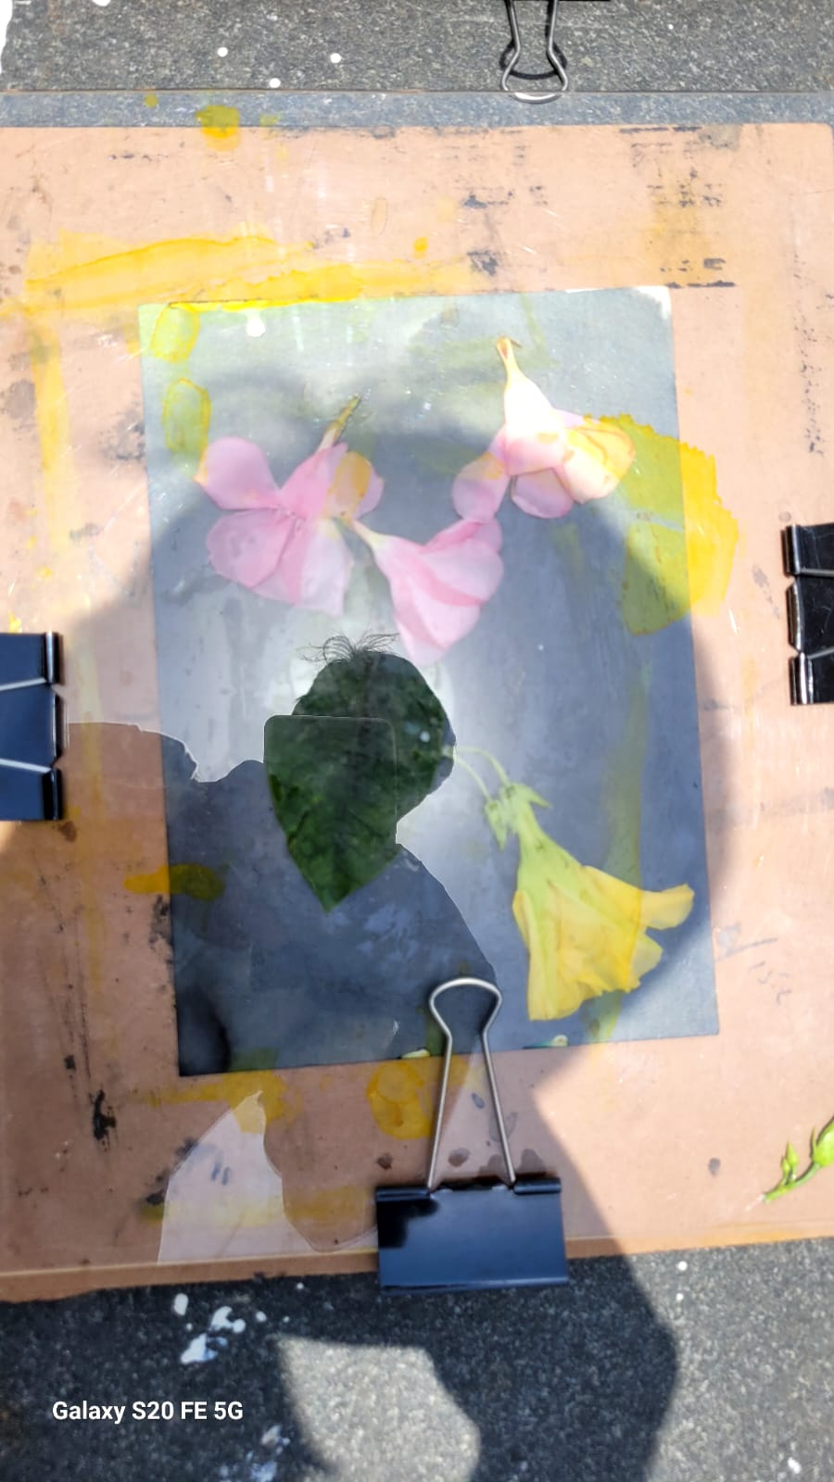
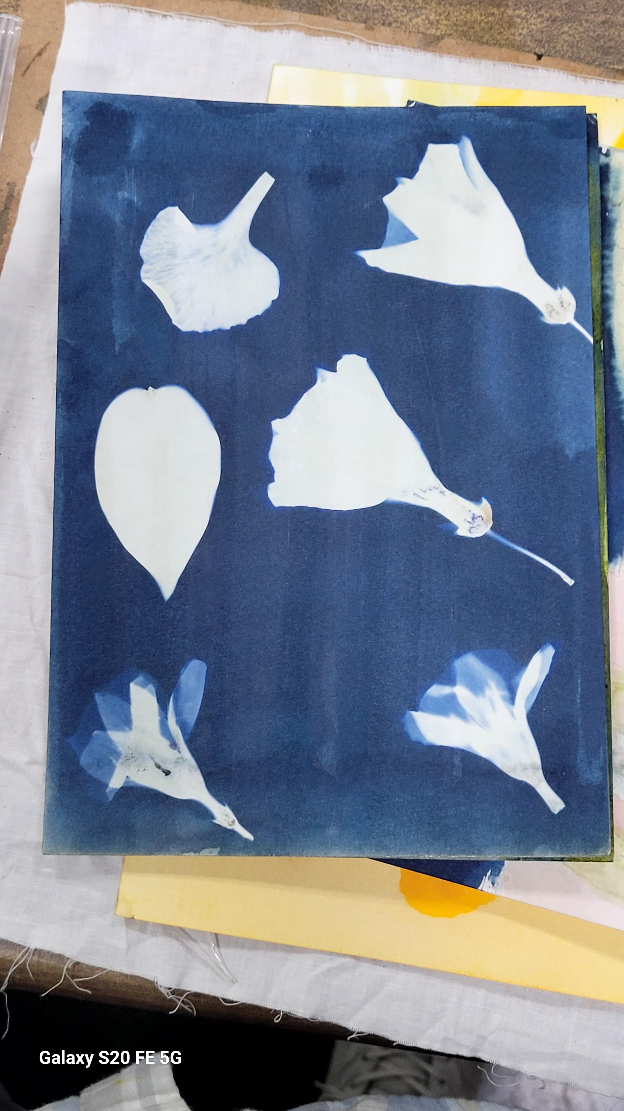
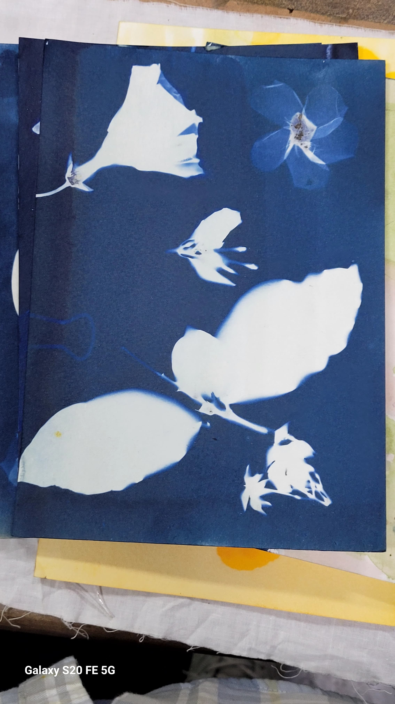
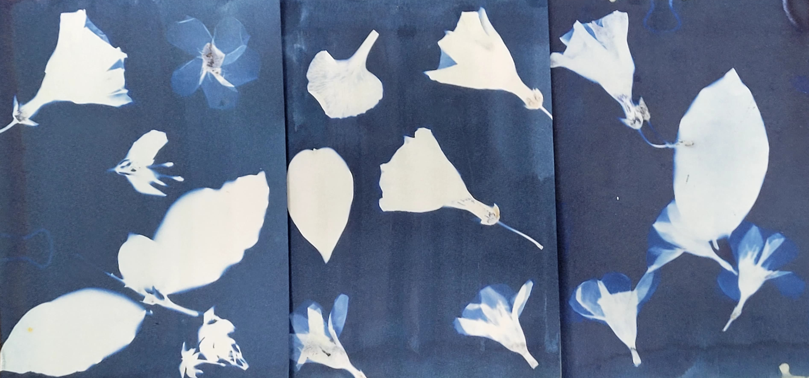
After 15 minute take it and wash it -
1ST – Wash in H20
2nd wash in H20+h2o2
3rd wash in again H2O
After completing this step, we can place it for drying.
Before completing the step
After completing the setup

Slide 23
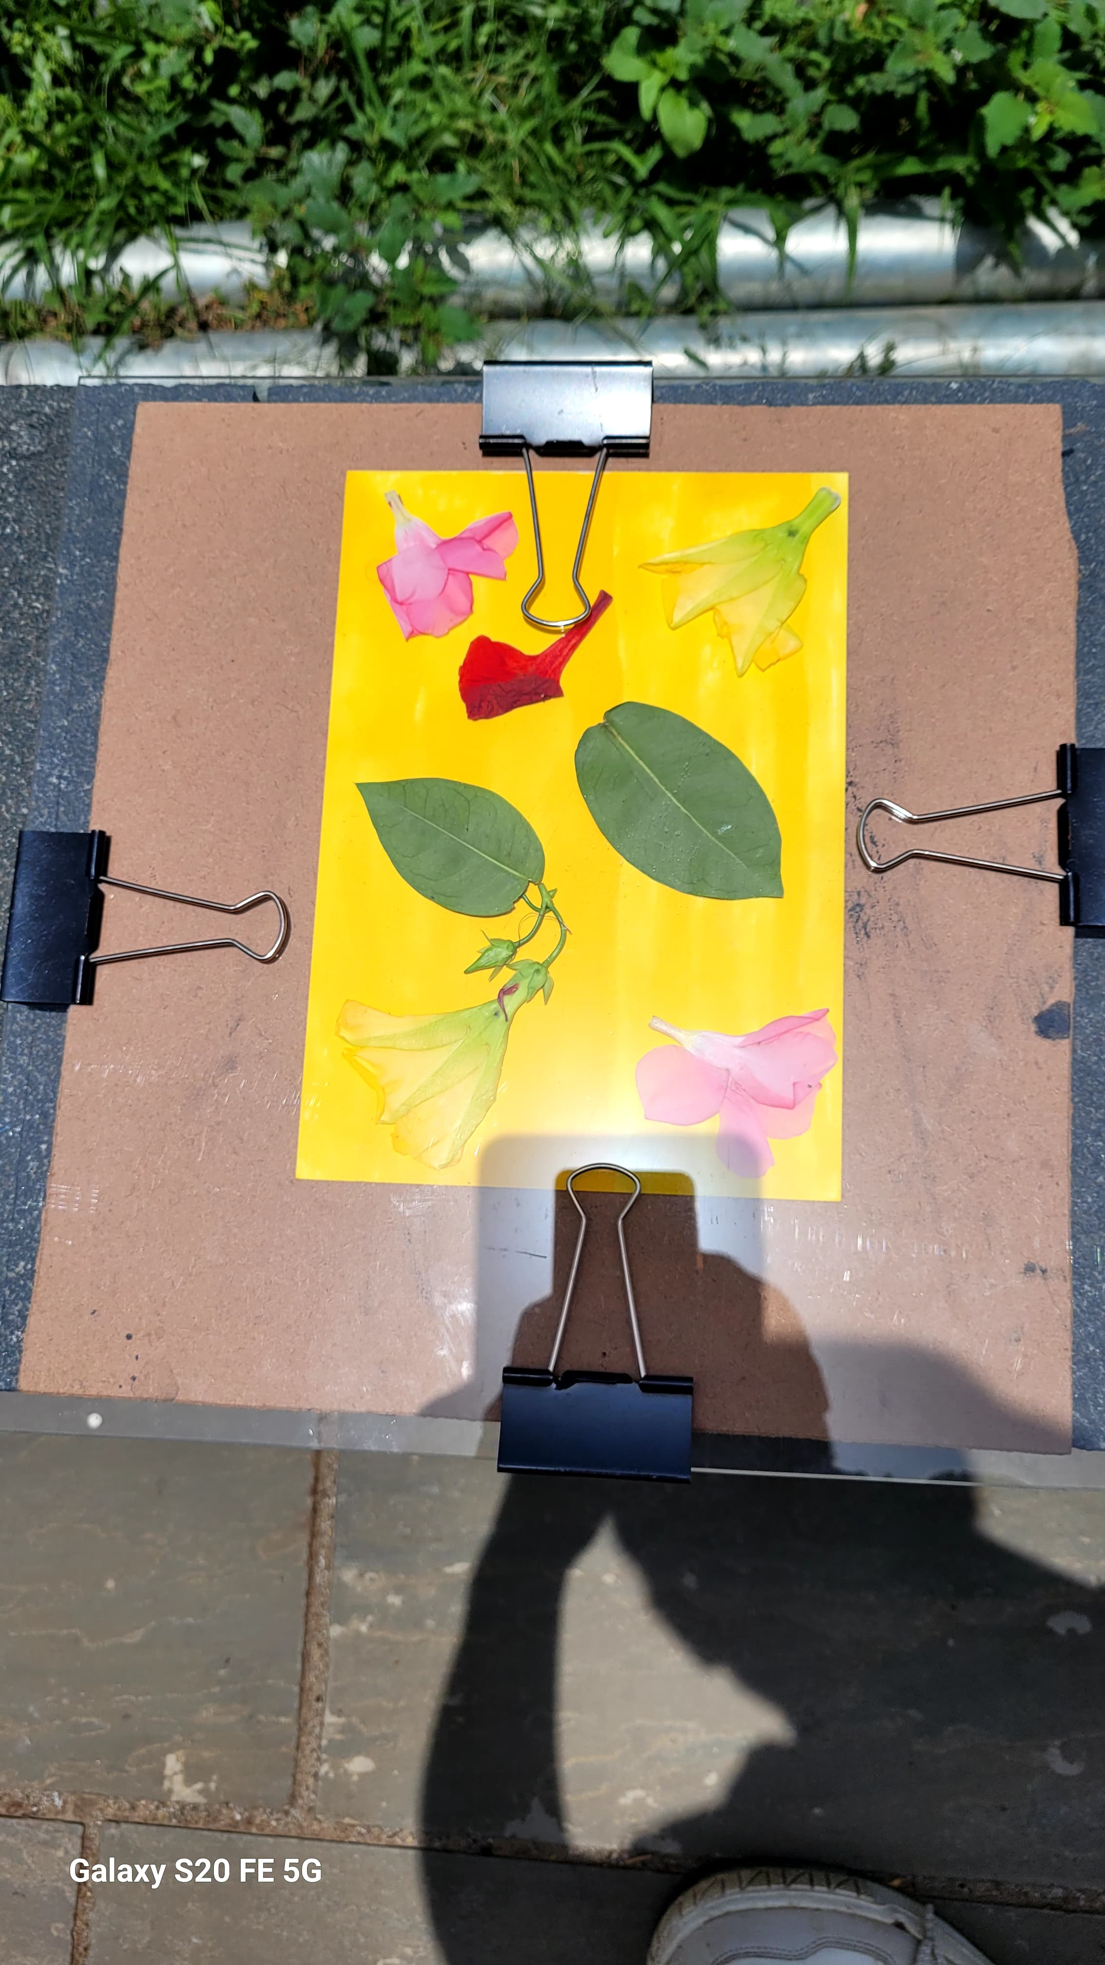
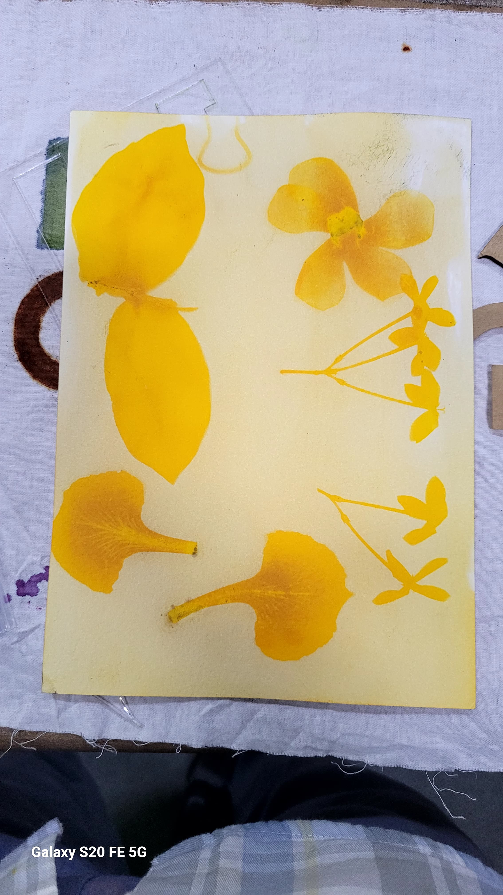
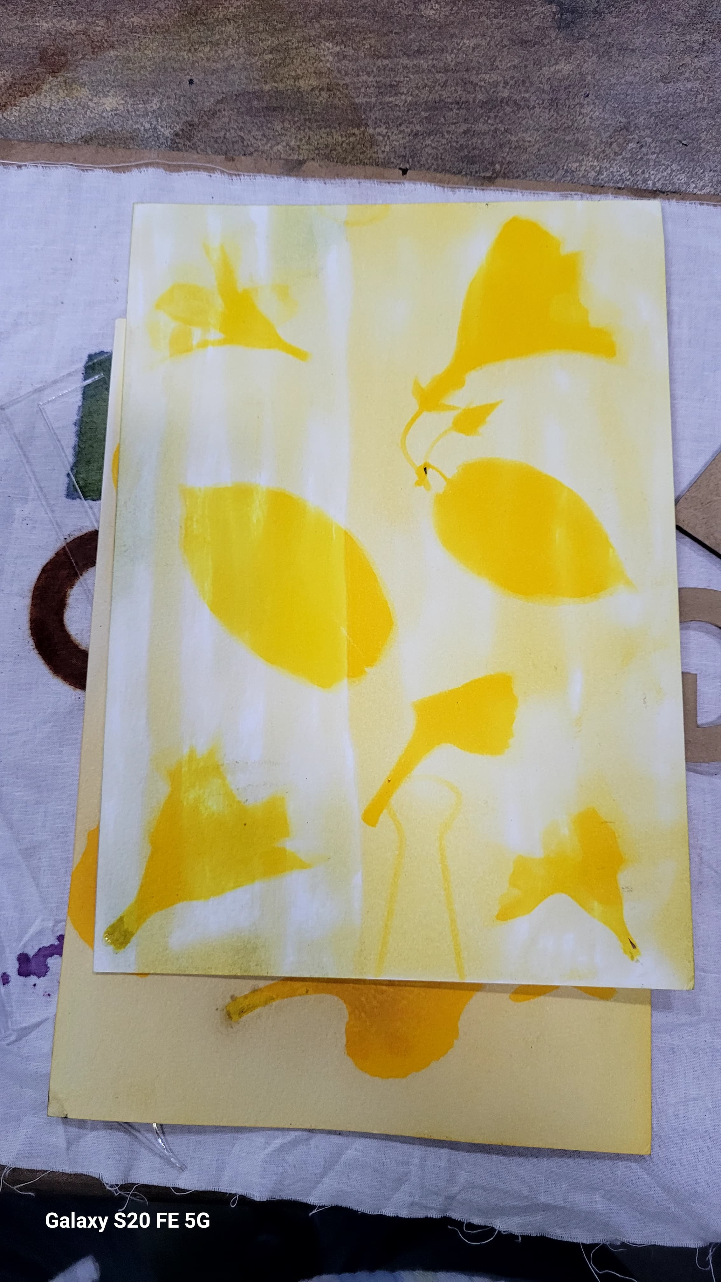
Anthotype
Isopropyl & Turmeric
take Upper Solution for brushing after this put it for drying in prersence of dark light . After drying the water colour paper do same step-
Exposure Setup:
Stack the materials in the following order:
Cardboard sheet
Coated brush paper (with the dried light-sensitive mixture)
Image on transparent sheet
Clip everything together
Leave it in the presence of sunlight for 4–5 hours. After that, take it out and check the print.

Slide 24
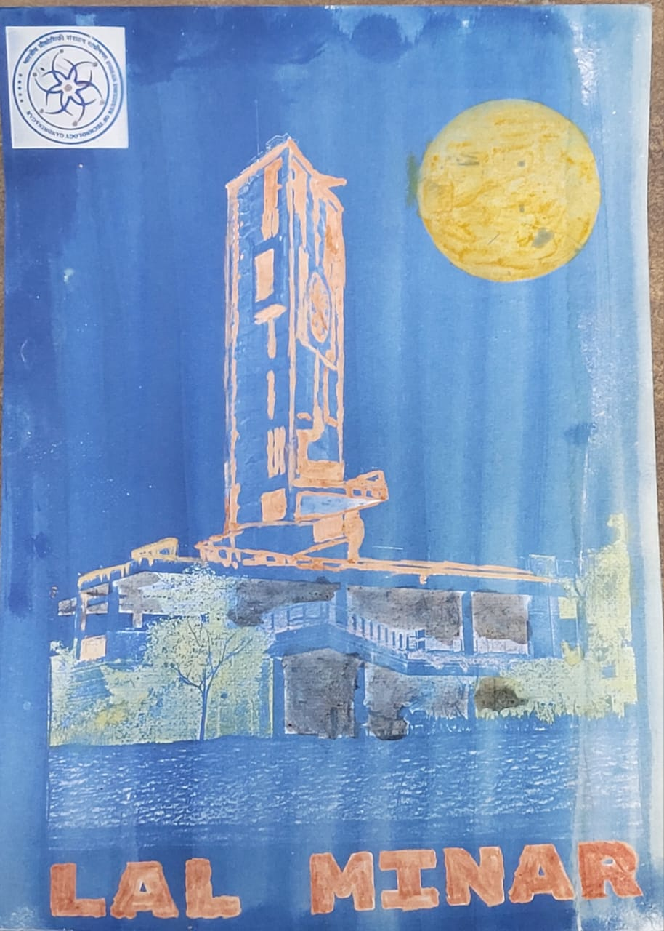
Cyanotype Process-
Solution Preparation:
Potassium ferricyanide – 0.8 g per 10 mL
Ammonium ferric citrate – 2 g per 10 mL → Mix both to form a light-sensitive mixture
Application:
Apply the light-sensitive mixture on watercolor paper using a brush.
Let it dry in the dark (protect from light).
Materials for Printing:
I. Transparent sheet
II. Cardboard sheet
Exposure Setup:
Stack the materials in the following order:
Cardboard sheet
Coated brush paper (with the dried light-sensitive mixture)
Image on transparent sheet
Clip everything together

Slide 25
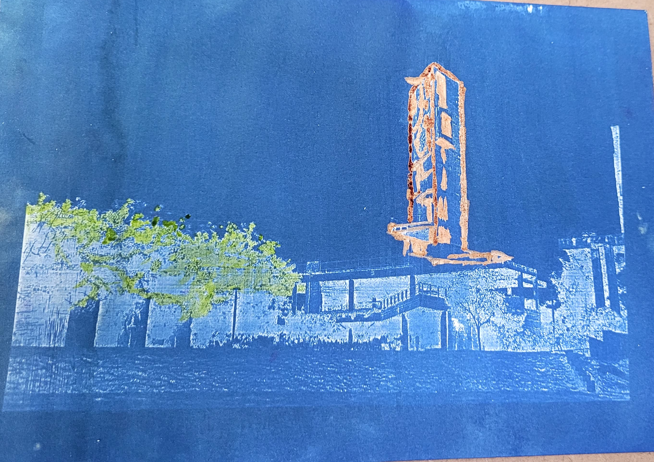
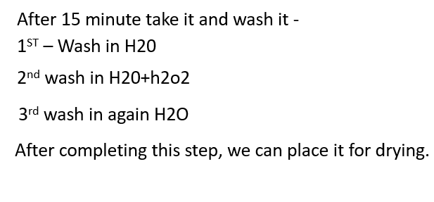
After completing the cyanotype process, we created red and green colors using natural materials—turmeric mixed with Na₂CO₃ for red, and spinach for green. After preparing the colors, we brushed them onto the image
Turmeric+Na2CO3
Spinach

